Slide 1
Title: VRCloudTech
Page: 1 - Introduction
Date: 04th August, 2019
Script: NIL
RMIT Univeristy Logo Here
Course Information Here
Action: Opening Scene. Show RMIT University Logo Here. Show course Information also. Effect TBD. Ambient music (TBD) to start and remain for duration of video.
Script: NIL until transition into Testimonial (see ‘Action’ below).
VRCloudTech Logo Here
Action: Continuation of Opening Scene. Show VRCloudTech Logo Here. Effect TBD. Start audio of testimonial from construction worker 1 now, 2 seconds prior to fade transition into interview.

Slide 2
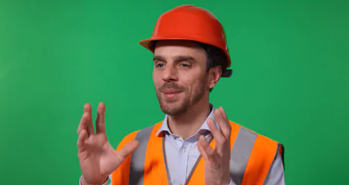
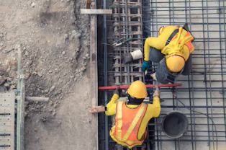
Title: VRCloudTech
Page: 2 – Testimonials Construction Worker 1
Date: 04th August, 2019
Script – Construction Worker 1:
“Our project today is at a stage that is one of the more complex stages of the project. Subcontractors have been let, demolition has been performed, steel and concrete has been ordered, so we are at a point where we are really just putting all our services - mechanical, electrical and hydraulic - in place. Of all projects, a reutilisation of an existing building is one of the more QA intensive projects when it comes to installing services that will satisfy the end users requirements.”
Action: Video interview. Fake name and job title to appear in lower corner. Close up shot. Single Interviewee. Looking at interviewer and not directly at camera. Ambient music continues.
Script 1: NIL
Action: Transition to shots of construction site. Workers performing tasks. Approximately 20 to 30secs footage.

Slide 3
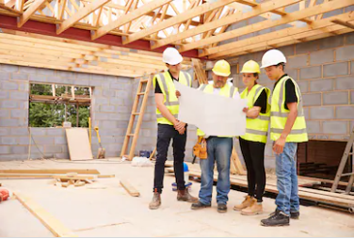
Title: VRCloudTech
Page: 3 – Testimonials Construction Worker 1
Date: 04th August, 2019
Script – Construction Worker 1:
“So, by utilising VRCloudTechs web-based VR/AR application, and immersing yourself into the project and seeing these scopes of work and seeing where all the new services were going in in comparison to existing facilities, it was really interesting to have this sense of immersion into a project and have this better understanding if design intent was on par with client requirements. You can actually see the walls, you can walk the job site, see what is to be installed, it will change the future of building.”
Action: back to video interview. Close up shot. Single Interviewee. Looking at interviewer and not directly at camera. Ambient music continues.
Transition into on site footage throughout testimonial to fill space and keep video interesting. Use footage of working prototype. Footage of people using VR headset (samsung).

Slide 4
Title: VRCloudTech
Page: 4 – Testimonials Worker 2 (Member who holds authority e.g. Project Manager, Contracts Administrator, Company Director)
Date: 04th August, 2019
Script – Worker 2:
“This technology, it will change my job by making it another tool for us to communicate our efforts of modelling and coordination with other people both installing and quality assurance and quality control aspect of the job. I think it is going to help out tasks such as service coordination simply because they are going to see the collisions that may occur between services that may occur within the ceiling spaces and situations that fall within the walls, so I think this will help them immensely by getting ahead of the programme by catching these issues as the arise.”
Action: Video interview. Fake name and job title to appear in lower corner. Close up shot. Single Interviewee. Looking at interviewer and not directly at camera. Change direction of ‘over the shoulder’ shot . Ambient music continues.
Action 2:
Transition back and forth into work site footage. Shots of the application on a laptop (prototype does not need to work). Footage of people using VR headset (samsung).

Slide 5
Title: VRCloudTech
Page: 5 – Testimonials Worker 2 (Member who holds authority e.g. Project Manager, Contracts Administrator, Company Director)
Date: 04th August, 2019
Script – Worker 2:
“It has the potential to answer alot of the questions and issues that we have, there are applications that exist already for pre-construction phases of a build, but what this web application does is it puts the power of design and visual immersion into the hands of the people out there in the field, and thats what i think is the most powerful benefit this application has. In the end, as a Builder, it has the potential to intercept alot of everyday issues.”
Action: Video interview. Fake name and job title to appear in lower corner. Close up shot. Single Interviewee. Looking at interviewer and not directly at camera. Change direction of ‘over the shoulder’ shot . Ambient music continues.
Action 2:
Transition back and forth into work site footage. Shots of the application on a laptop (prototype does not need to work)

Slide 6
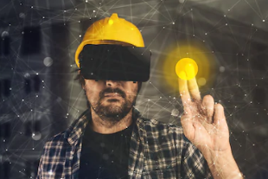
Title: VRCloudTech
Page 6: VRCloudTech Application Description
Date: 04th August, 2019
Voice Over:
Introduction to VRCloudTech
Description of the problem VRCloudTech is trying to solve.
Action: Animated Infographics (Data to be provided by Kyle S.)
VRCloudTech Logo Here
Voice Over:
Objective of VRCloudTech
Objective of the web-based VR/AR application
Information from Assignment 2.
Action: Shots of web application. Prototype or indicative interface. Transition back and forth between stills of product.
Animations of VR application in use.

Slide 7
Title: VRCloudTech
Page 7: VRCloudTech Closing
Date: 04th August, 2019
Voice Over:
Closing Statement.
Action: Animated Logo. Fade Out. Ensure Company colours present throughout fade out of video.
VRCloudTech Logo Here

